Slide 1


Automated Freshness Classification
A custom Convolutional Neural Network (CNN) for rapid and accurate fruit and vegetable freshness assessment.

Slide 2




EXECUTIVE SUMMARY
Precision Produce AI
Custom CNN Development
Comprehensive Dataset
Built from scratch for optimal performance.
Trained on 5 fruit types (fresh/rotten).
99.45% Accuracy
Automated Efficiency
Exceptional performance across all metrics.
Potential for significant industry impact.

Slide 3


Addressing Food Industry Challenges
The food industry grapples with subjective, time-consuming, and error-prone manual produce inspection. This leads to inconsistencies and considerable food waste.
Manual Inspection Flaws
Subjective and inconsistent
Time-consuming operations
Prone to human error
Our Deep Learning Solution
Automated, reliable, efficient
Robust CNN image analysis
Scalable and precise classification

Slide 4
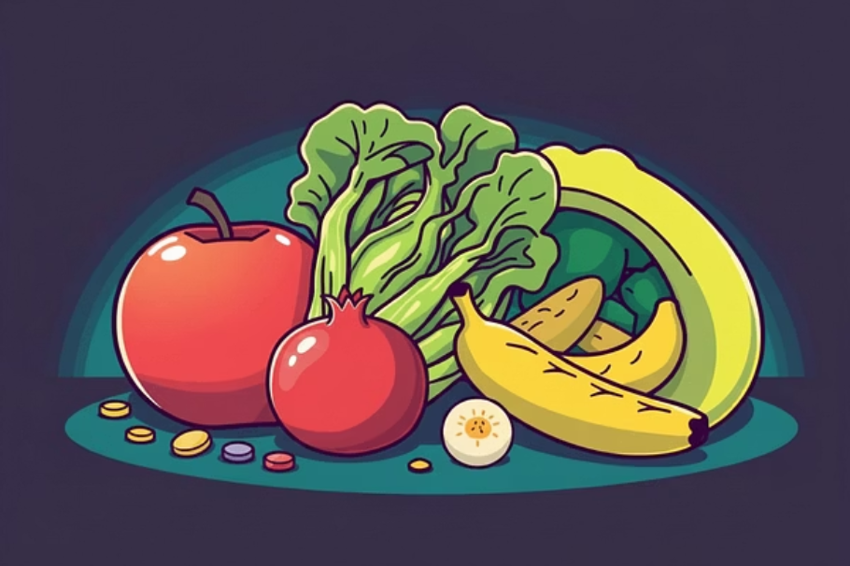
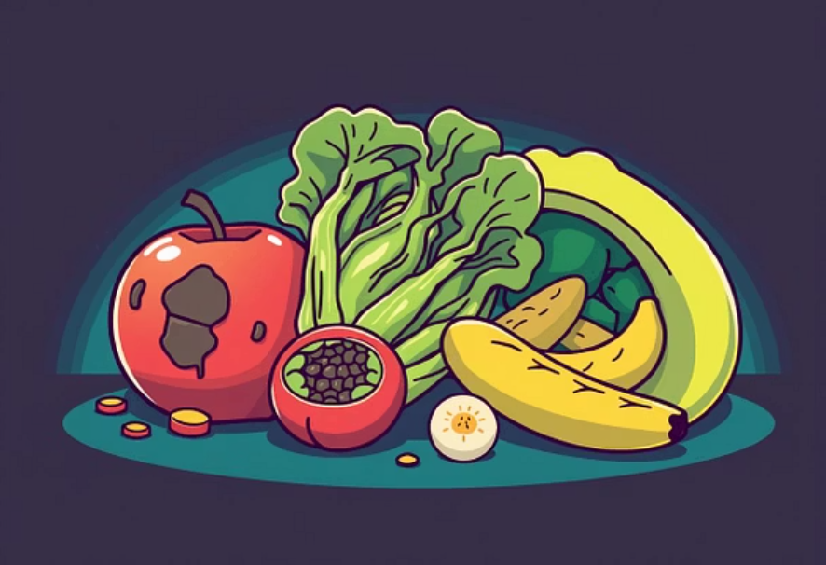
Methodology: Data Preparation
A systematic approach to data handling was crucial for training a robust and generalizable model.
1
2
3
Dataset Consolidation
Data Partitioning
10 Distinct Classes
Unified image dataset of fruits and vegetables, consolidating sub-species under primary types.
Training: 11,701 images
Five fruit types, each with "fresh" and "rotten" states.
Validation: 2,919 images
To ensure model robustness, we applied extensive data augmentation and class weighting techniques.

Slide 5
Methodology: Augmentation & Architecture
Data Augmentation
Custom CNN Architecture
Applied to the training dataset to mitigate overfitting and improve generalization.
Designed from the ground up for optimal fruit and vegetable feature extraction. Input shape: (100, 100, 3).
Rescaling: Normalized pixel values to [0, 1].
01
Random Rotation: Up to 20 degrees.
3 Conv Blocks
Random Shift: Up to 20% horizontally/vertically.
Conv2D, BatchNormalization, MaxPooling2D, Dropout.
Horizontal Flip: Randomly flipped images.
02
Increasing Filter Depth
Random Zoom: Up to 20% zoom in.
32, 64, then 128 filters.
03
Dense Layers
Flattened feature maps to 256 then 128 neurons (50% dropout).
04
Output Layer
10 neurons with Softmax activation for classification.

Slide 6





Methodology: Training Configuration
The model was meticulously configured for optimal convergence and performance.
Adam Optimizer
Categorical Crossentropy
EarlyStopping
Efficient adaptive learning rate (initial: 0.001).
Loss function for multi-class classification.
Halts training if validation loss stagnates (patience=10).
ReduceLROnPlateau
ModelCheckpoint
Reduces learning rate by 0.5 if validation accuracy stagnates.
Saves best-performing model weights based on validation accuracy.

Slide 7
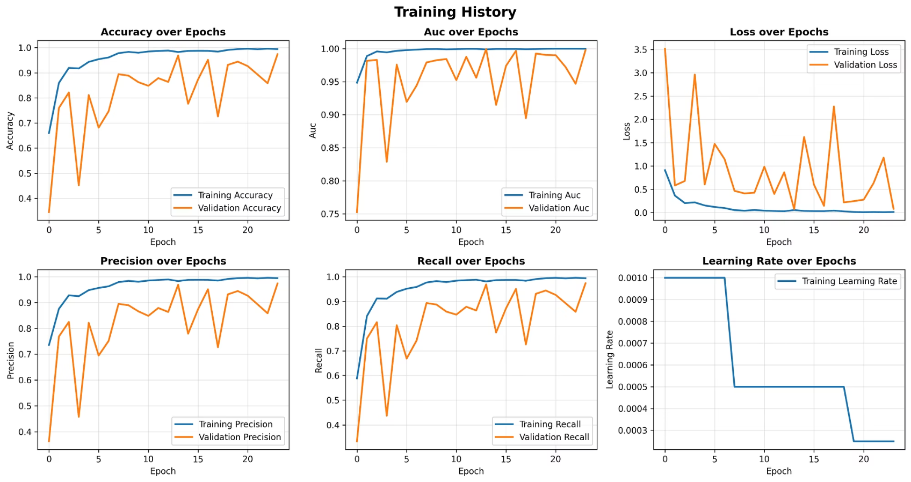
Training History & Overfitting Control
The model trained for 24 epochs, with optimal weights restored from epoch 14 by EarlyStopping.
Rapid Learning
1
Training accuracy and AUC quickly approached 1.0.
2
Validation Trend
Validation curves followed a positive, albeit fluctuating, trend.
Overfitting Gap
3
A gap emerged between training and validation, indicating some overfitting.
4
Regularization Success
Dropout and BatchNormalization effectively controlled overfitting to a manageable level.

Slide 8
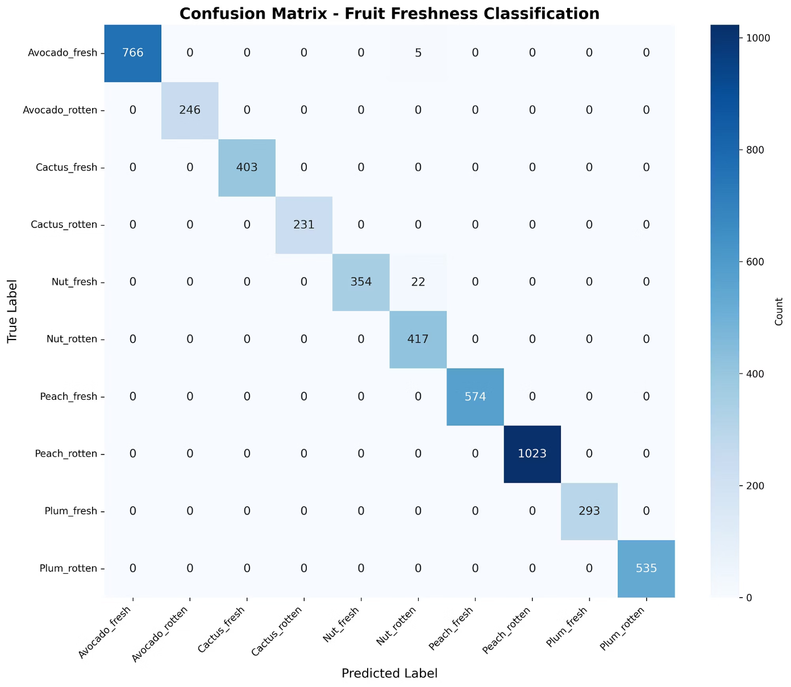
Confusion Matrix & Qualitative Analysis
Confusion Matrix Insights
The matrix shows strong diagonal results, indicating high accuracy across most classes.
Perfect Accuracy: Achieved for Avocado\_rotten, Cactus\_fresh, Cactus\_rotten, Peach\_fresh, Peach\_rotten, Plum\_fresh, and Plum\_rotten.
Nut Category Error: 22 Nut\_fresh images misclassified as Nut\_rotten (94.15% accuracy for Nut\_fresh).
Significance: Misclassifications were contained within the same fruit type, suggesting subtle visual differences for nuts.
Qualitative analysis of sample predictions confirmed high confidence (typically 100%) for correct classifications, reinforcing model reliability.

Slide 9
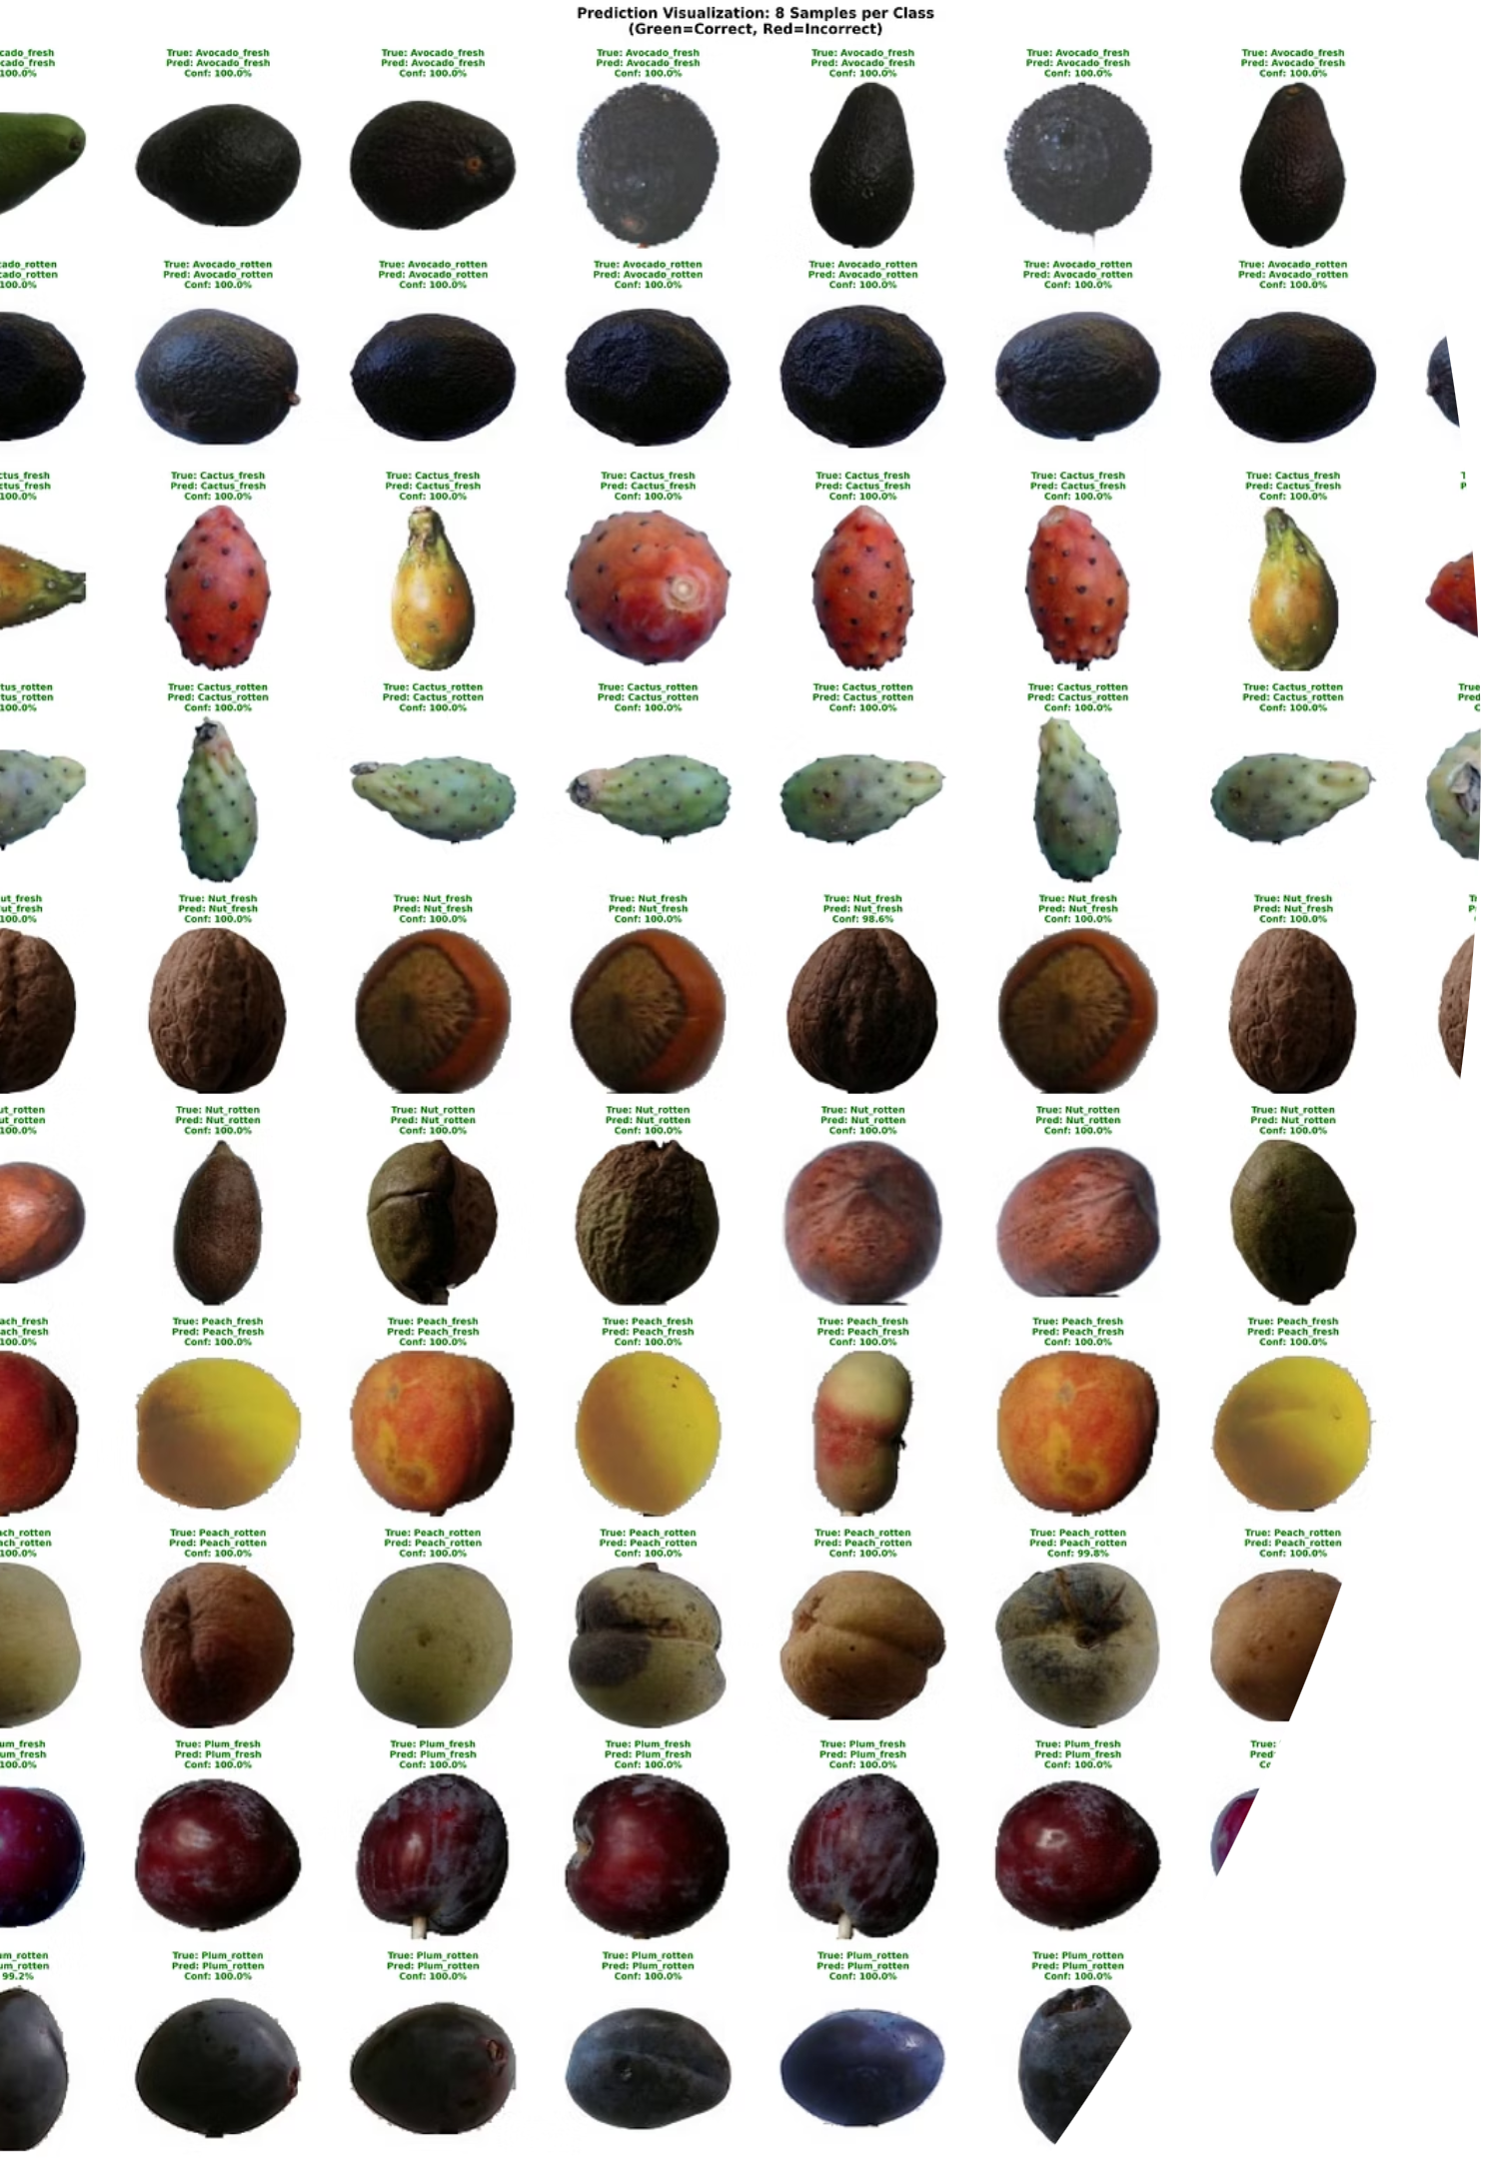
Outstanding Performance Metrics
The model achieved exceptional results on the unseen test dataset, validating its efficacy.
99.45%
99.45%
Accuracy
Precision
Overall correct predictions.
Very few false positives.
99.45%
1.00
Recall
AUC Score
Very few false negatives.
Perfect class-separability.
These balanced and high scores across all metrics confirm the model's robustness and reliability.

Slide 10

Conclusion & Recommendations
Future Work
Proven Efficacy
Targeted Nut Improvement
99.45% accuracy on diverse test set validates model's effectiveness and robustness.
Focus on specific data augmentations for nuts to differentiate fresh/rotten states.
Real-World Ready
Transfer Learning Exploration
High precision/recall makes it suitable for automated quality control, increasing throughput.
Benchmark against pre-trained models (e.g., MobileNetV2) for performance and efficiency comparison.
Dataset Expansion
I

